Slide 1

Efficacy of Fungicides for FHB and DON Management:
Product, Timing, and Number of Applications
Dr. Pierce A. Paul
The Ohio State University

Slide 2
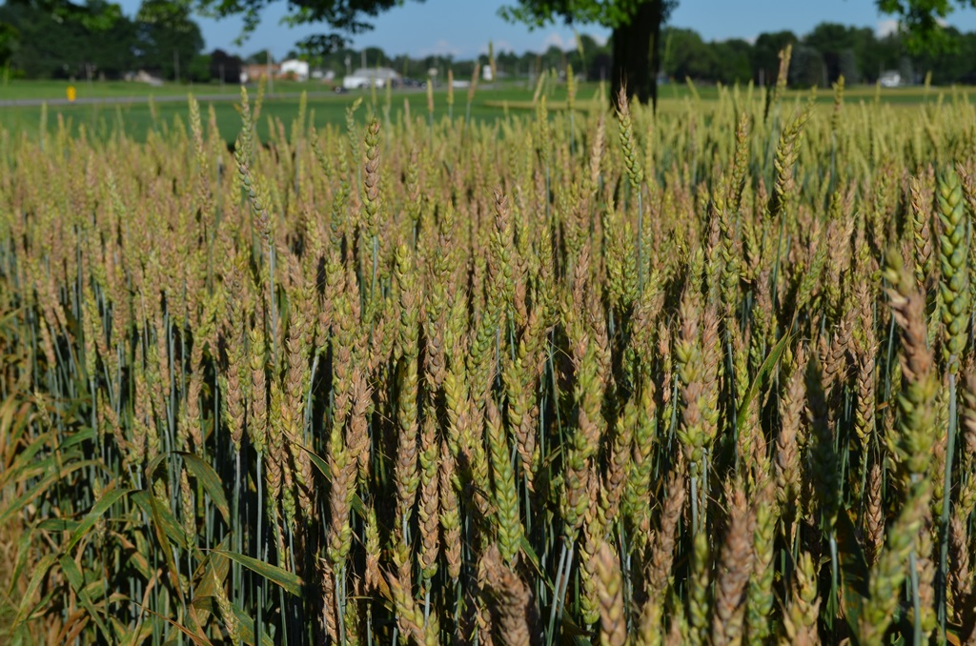
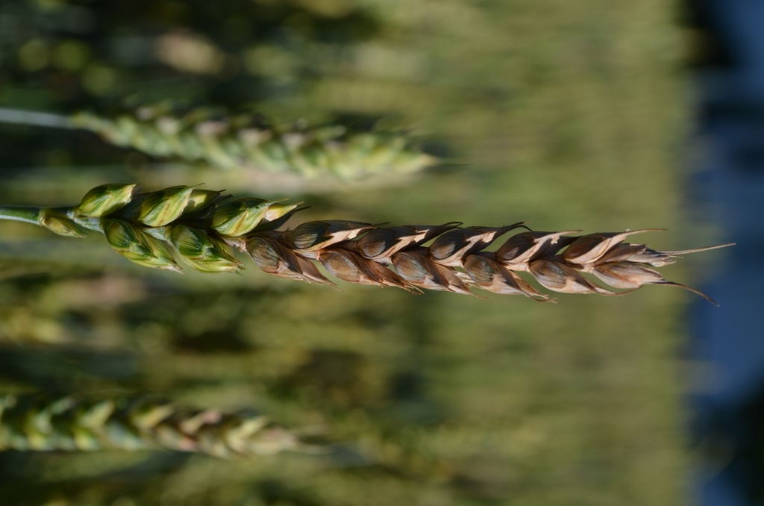
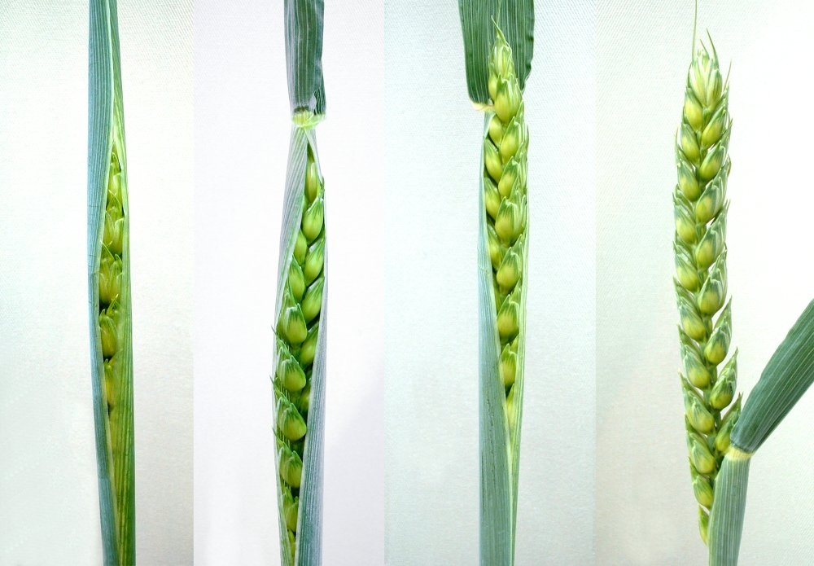
Fusarium head blight (head scab)
Fusarium graminearum (Gibberella zeae)
Grain yield and quality losses
Grain contamination with mycotoxins
Food safety concerns – humans and animals
Reduce flour yield and milling and baking quality

Slide 3
Tilt
Folicur
Proline
Prosaro
Caramba
Sphaerex
Miravis Ace
Prosaro Pro
20
Products
8
Scab
Products

Slide 4
Fungicides for Fusarium head blight and DON Control
Folicur and generics
Tebuconazole
Tilt and generics
Propiconazole
Caramba
Triazole
Prothioconazole
Proline
Metconazole
Prosaro
Sphaerex
Fluopyram
Miravis Ace
SDHI
Prosaro Pro
Pydiflumetofen

Slide 5


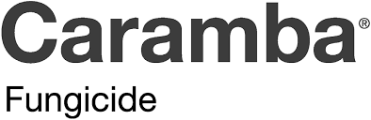
UFT Fungicide Programs:
Product, Timing, Single vs Double Applications

Slide 6
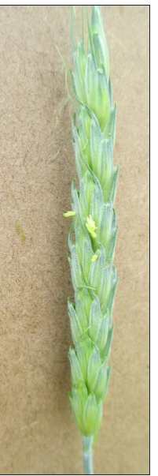
Timing effect on FHB and DON
10.1
10.2
10.3
10.5.1
Warrick Texas A&M - https://soilcropandmore.info/Newsletter/nl042005.htm
Knott UK - https://mccracken.ca.uky.edu/files/identifying_wheat_growth_stages_agr224.pdf

Slide 7
Fungicide Programs
Treatment program | Treatment Program | Rate (fl oz/A) | Timing
Code | Product
CK | Nontreated | --- | ---
PRO_A | Prosaro | 6.5 | Feekes 10.5.1
CAR_A | Caramba | 13.5 | Feekes 10.5.1
MIR_H | Miravis Ace | 13.7 | Feekes 10.3
MIR_A | Miravis Ace | 13.7 | Feekes 10.5.1
MIR_L | Miravis Ace | 13.7 | 4-6 DAA
MIR_PRO | Miravis Ace fb Prosaro | 13.7/10.3 | Feekes 10.5.1/4-6 DAA
MIR_CAR | Miravis Ace fb Caramba | 13.7/7.3 | Feekes 10.5.1/4-6 DAA
PIR_FOL | Miravis Ace fb Tebuconazole | 13.7/4.0 | Feekes 10.5.1/4-6 DAA
DAA = days after anthesis (Feekes 10.5.1)
All treatments applied with a non-ionic surfactant @ 0.125% V/V

Slide 8
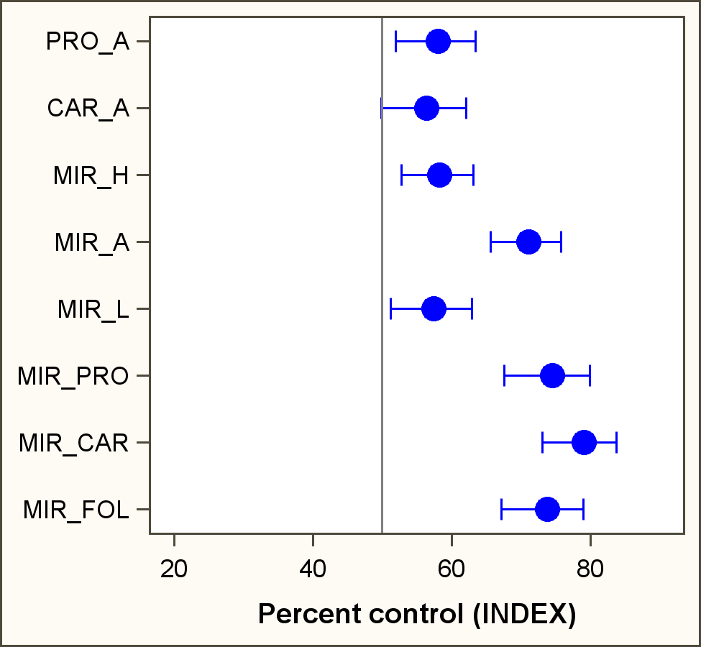
Percent Control of FHB
Product
Single Spray
Timing
Two sprays

Slide 9
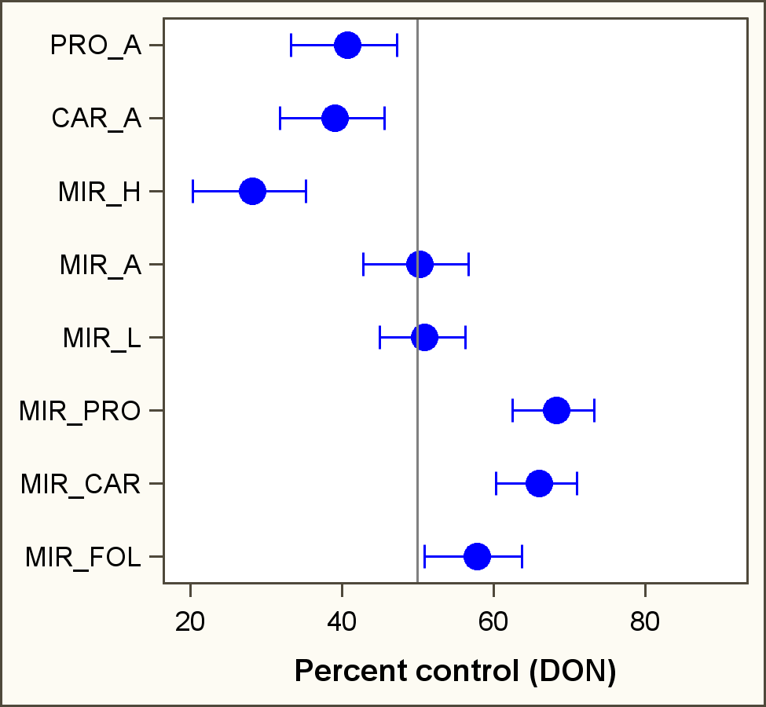
Percent Control of DON
Product
Single Spray
Timing
Two sprays

Slide 10


UFT Fungicide Programs:
“NEW” vs “OLD”, Single vs Double Applications

Slide 11
Fungicide Programs
Treatment program | Treatment Program | Rate (fl oz/A) | Timing
Code | Product
CK | Nontreated | --- | ---
I | Prosaro | 6.5 | Feekes 10.5.1
II | Caramba | 13.5 | Feekes 10.5.1
III | Miravis Ace | 13.7 | Feekes 10.5.1
IV | Prosaro Pro | 10.3 | Feekes 10.5.1
V | Sphaerex | 7.3 | Feekes 10.5.1
VI | Miravis Ace fb Prosaro Pro | 13.7/10.3 | Feekes 10.5.1/4-6 DAA
VII | Miravis Ace fb Sphaerex | 13.7/7.3 | Feekes 10.5.1/4-6 DAA
VIII | Miravis Ace fb Tebuconazole | 13.7/4 | Feekes 10.5.1/4-6 DAA
DAA = days after anthesis (Feekes 10.5.1)
All treatments applied with a non-ionic surfactant @ 0.125% V/V

Slide 12
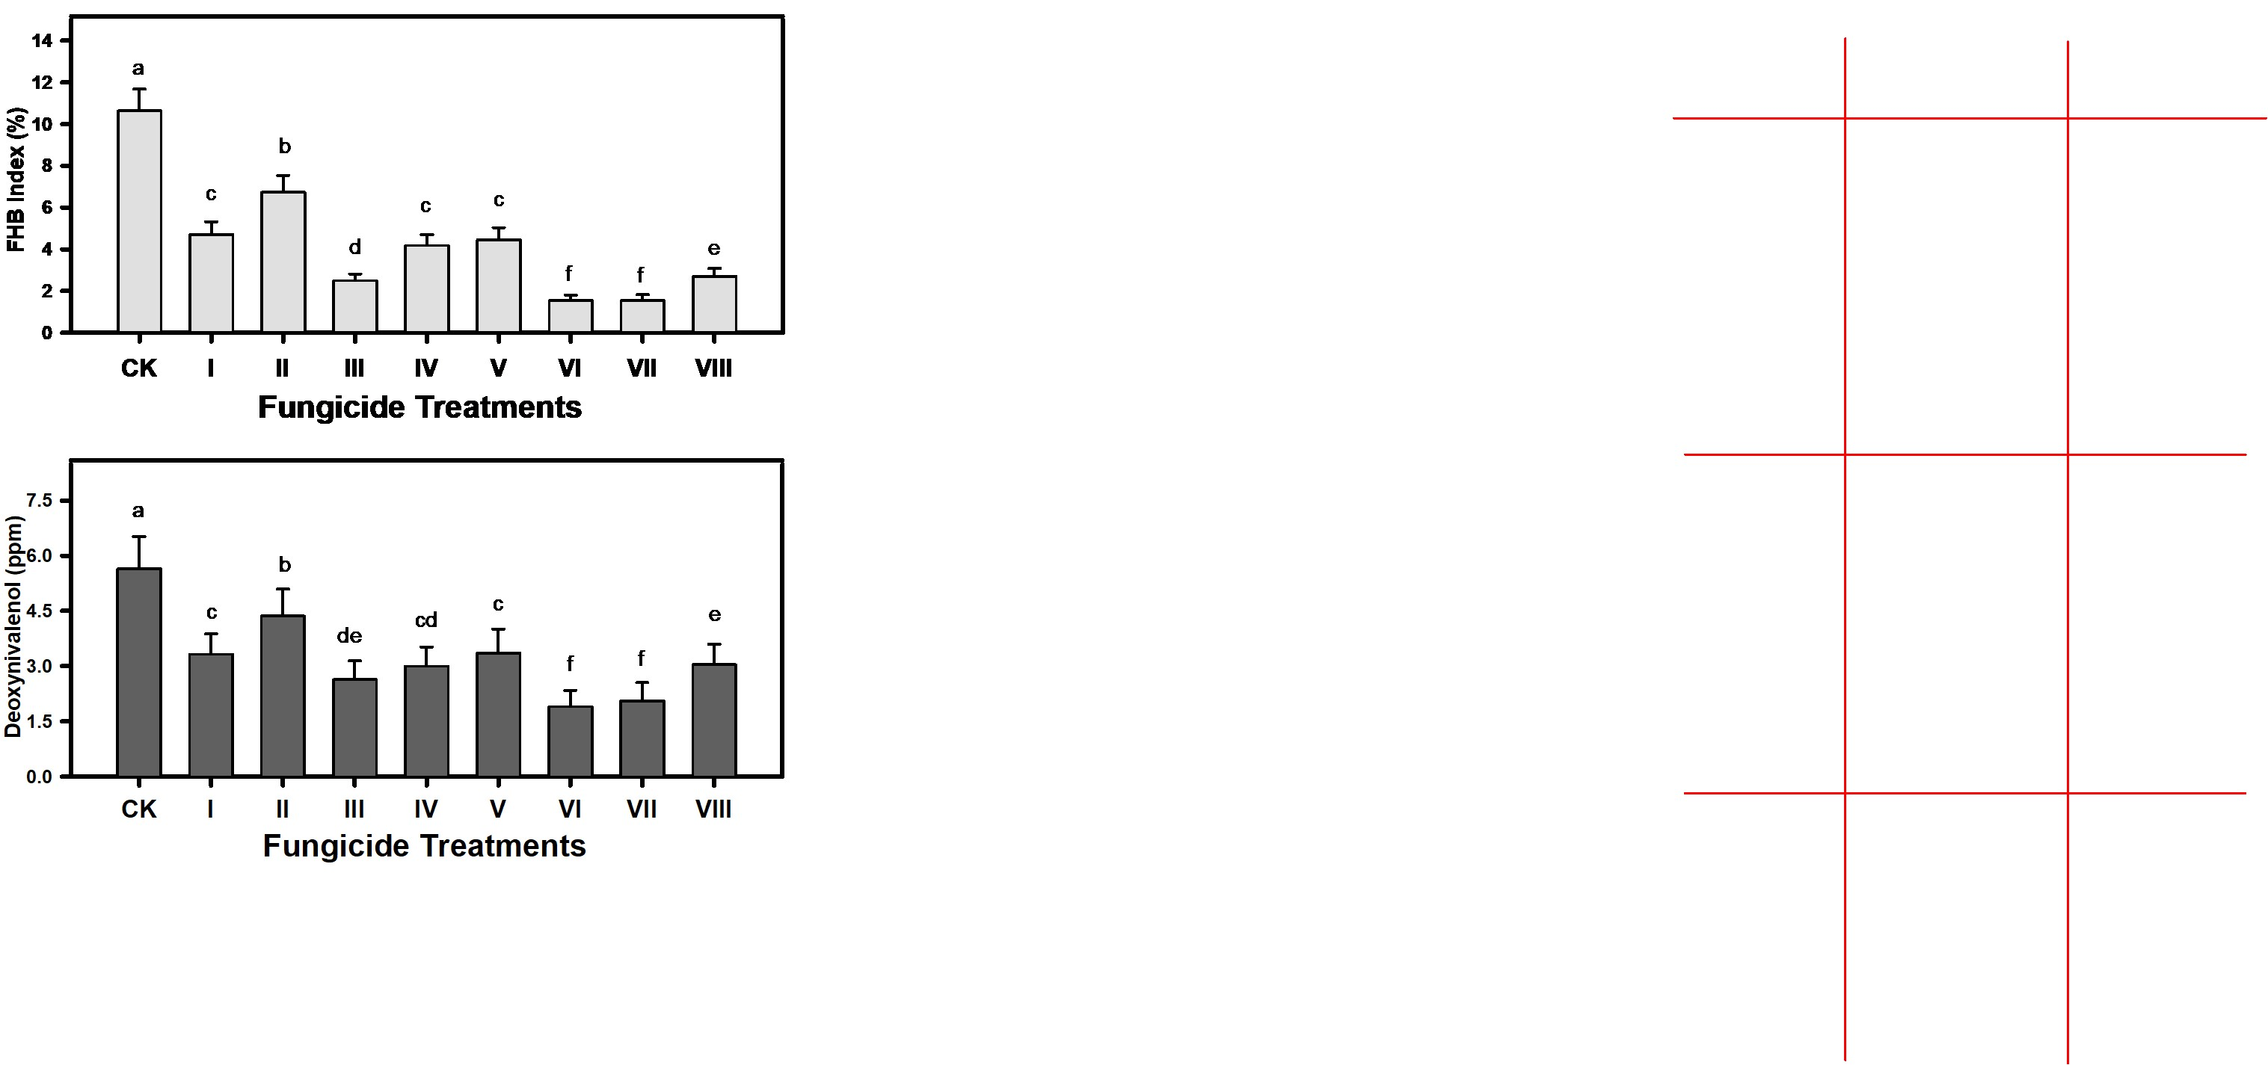
Fungicide effects on FHB
Prosaro
(55%)
Caramba
(37%)
Miravis Ace
(76%)
Prosaro Pro
(60%)
Sphaerex
(58%)
Two-
Treatment
(58-74%)

Slide 13
Fungicide effects on FHB
Caramba
(37%)
Sphaerex
(58%)

Slide 14
Fungicide effects on FHB
Prosaro
(55%)
Prosaro Pro
(60%)

Slide 15
Fungicide effects on DON
Prosaro
(41%)
Caramba
(23%)
Miravis Ace
(53%)
Prosaro Pro
(47%)
Sphaerex
(40%)
Two-
Treatment
(46-66%)

Slide 16
Fungicide effects on DON
Caramba
(23%)
Sphaerex
(40%)

Slide 17
Fungicide effects on DON
Prosaro
(41%)
Prosaro Pro
(47%)

Slide 18
Take-home:
Miravis Ace at anthesis provided the best single-application control of FHB and DON
The early application of Miravis Ace was less effective against DON than an application at or shortly after anthesis
Prosaro Pro and Sphaerex were of comparable efficacy to Prosaro
Sphaerex was more effective than Caramba.
Two applications generally led to the highest levels of control, but future economic analysis will assess the cost:benefit.

Slide 19
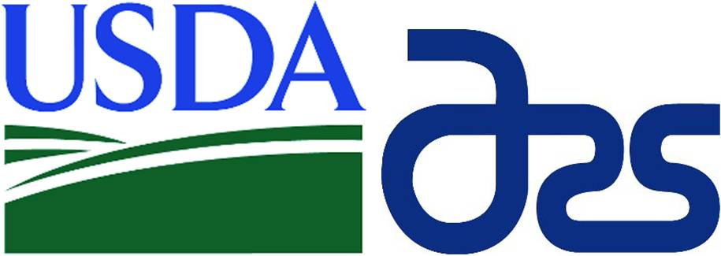
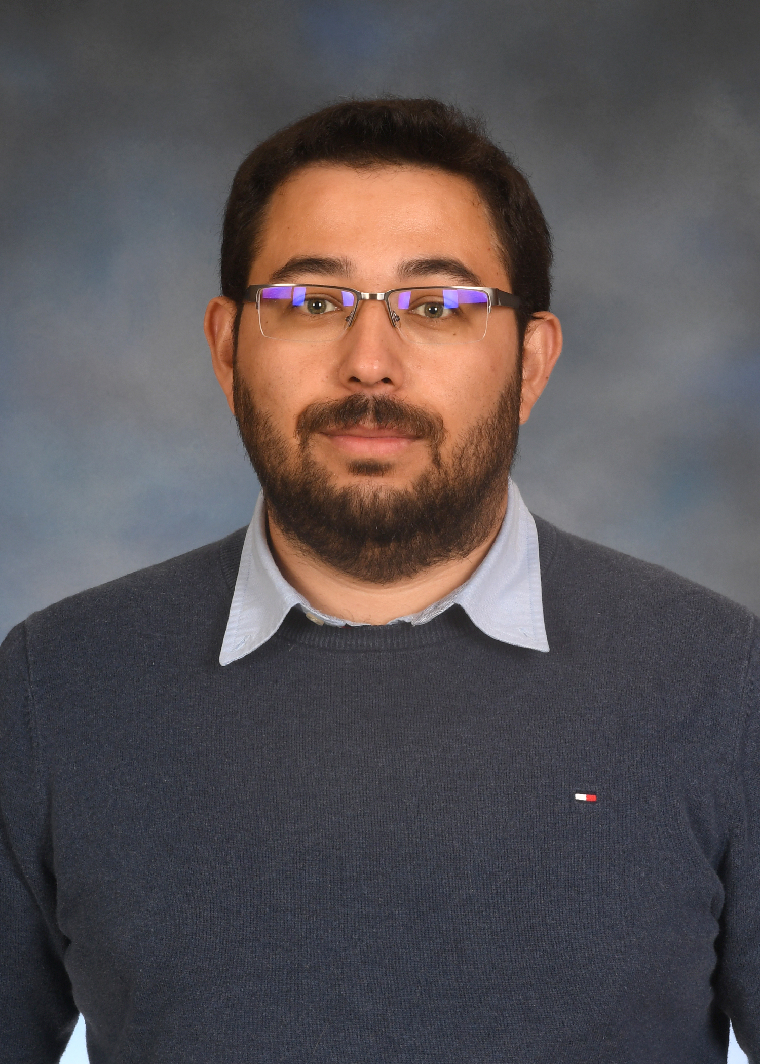
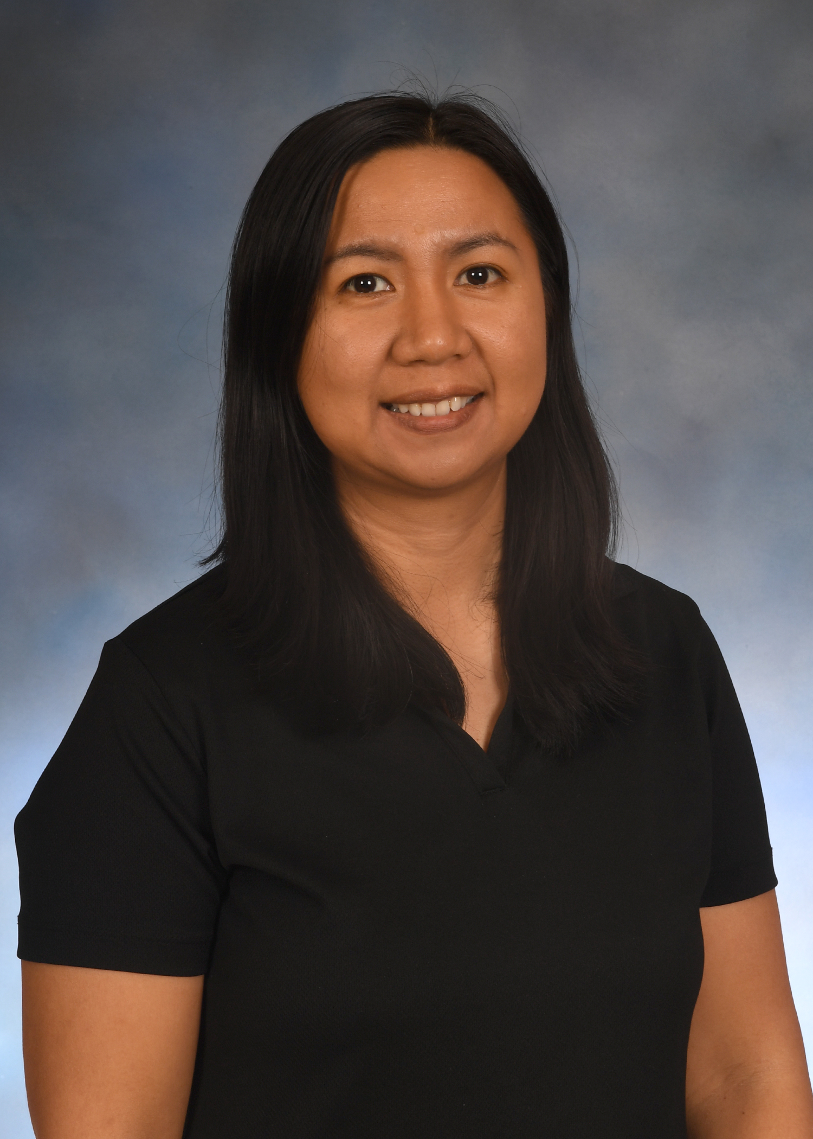
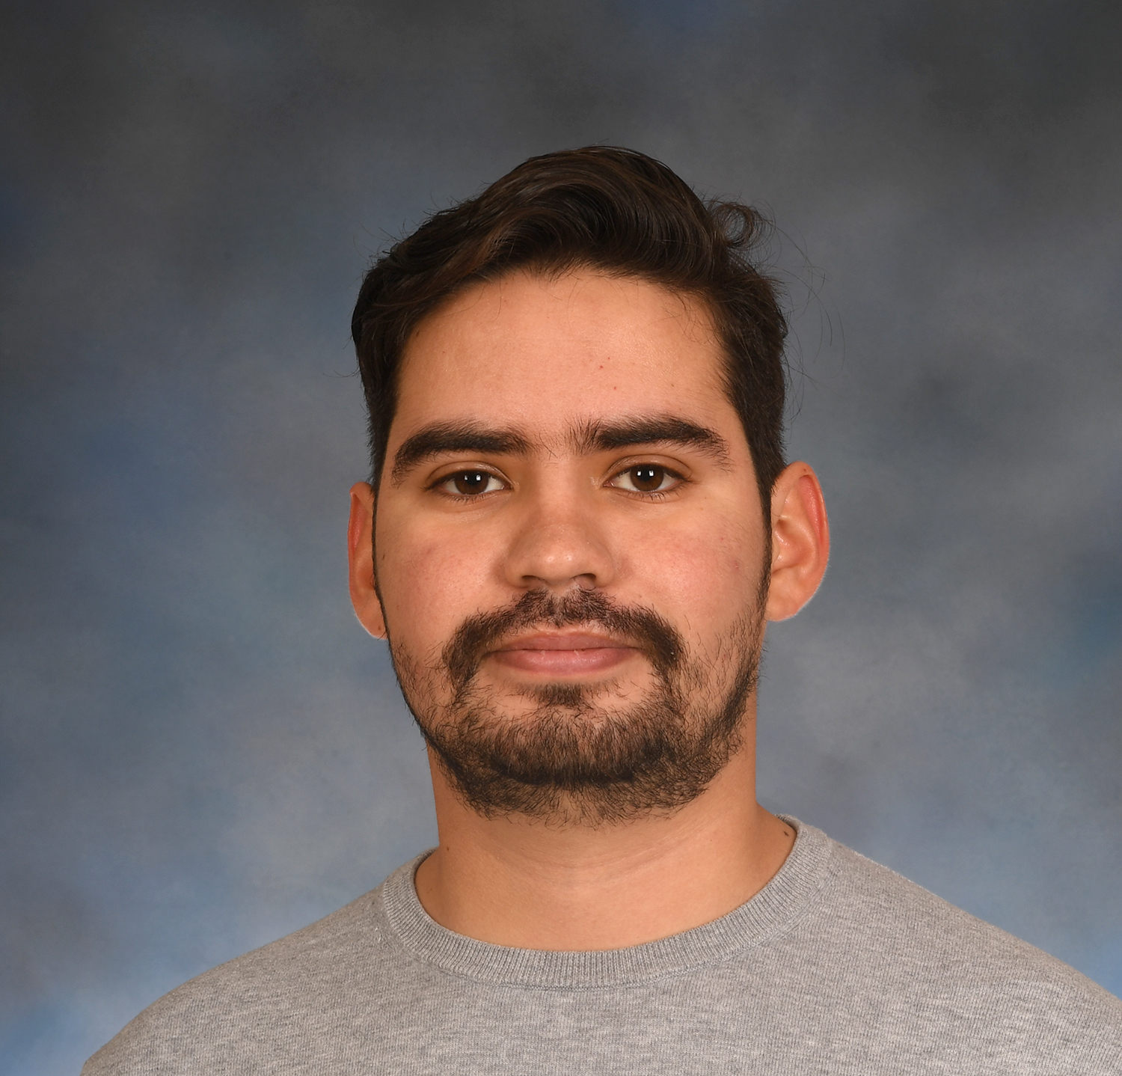
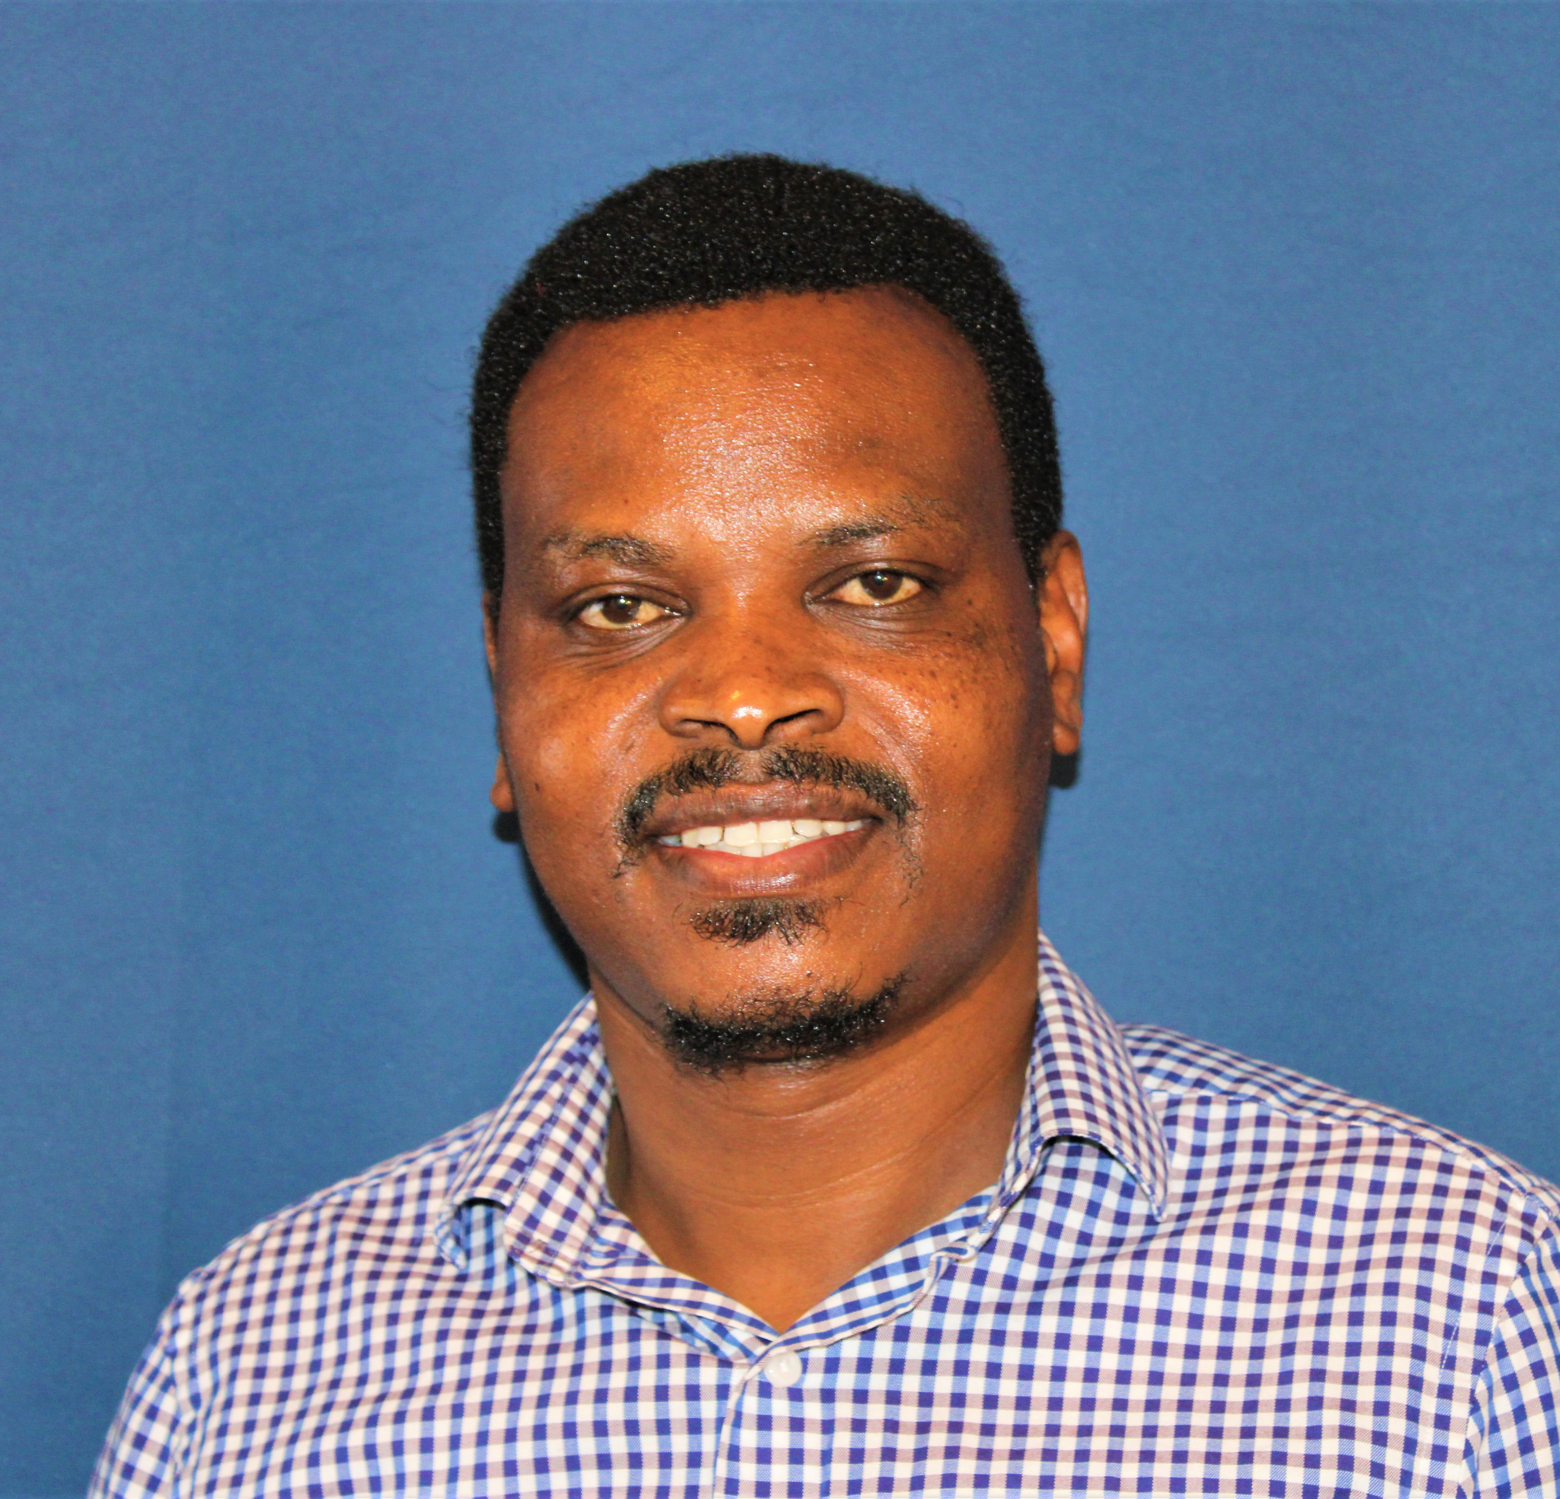

Acknowledgments
Dr. Moraes
Dr. Luis
Jorge
Dr. Kikway

Slide 20
Acknowledgments
Jane Marian Luis (OSU), Sin Joe Ng (OSU), Gary Bergstrom (Cornell), Kaitlyn Bissonnette (U Missouri), Kira Bowen (Auburn), Carl Bradley (U Kentucky), Emmanuel Byamukama (SDSU), Martin Chilvers (MSU), Alyssa Collins (PSU), Christina Cowger (NCSU/USDA-ARS), Heather Darby (U. Vermont), Erick DeWolf (KSU), Ruth Dill Macky (U Minnesota), Paul Esker (PSU), Andrew Friskop (NDSU), Nathan Kleczewski (U Illinois), Alyssa Koehler (U Delaware), Laurence Madden (OSU), Juliet Marshall (U Idaho), Hillary Mehl (Virginia Tech), Wanderson Moraes (OSU), Martin Negelkirk (MSU), Nidhi Rawat (U Maryland), Damon Smith (UW-Madison), Darcy Telenko (Purdue), Stephen Wegulo (U Nebraska-Linclon), and Heather Young-Kelly (U Tennessee).

Slide 21
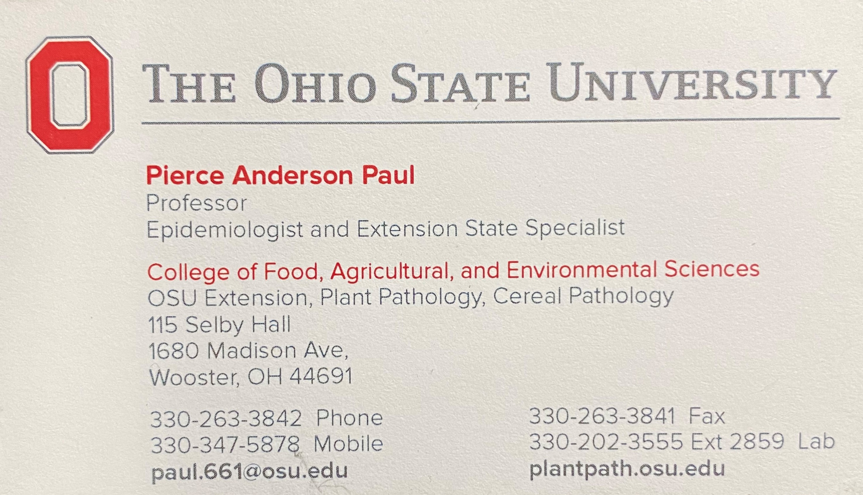
My Contact Information

